Slide 1



Chronic obstructive pulmonary disease
V6 dataset support session
Tuesday 3rd June
1:00-2:00pm

Slide 2

Welcome and housekeeping
This session will guide users through the key changes to the v6 dataset
Aim to explain the updates and provide rationale for the updates
Please ensure you are muted throughout the presentation however we encourage that you use the chat function to ask questions throughout
  The team will respond when possible and we will have a section for Q&A at the end
This session will be recorded and available upon request.
Slides will be shared with attendees
Notes:
Background on the COPD audit

Slide 3
COPD Key Performance Indicators (KPI’s)
KPI 1 – Acute treatment with NIV within 2 hours of arrival at hospital
  Poorly achieved KPI (service average of 18.6% for 2023/24) – feedback received confirming difficulty in administering NIV within 2 hours of arrival.
  Updated definition in line with NICE quality statement 7 (2023)
  New definition: Acute treatment with non-invasive ventilation (NIV) within 1 hour of diagnosis of persistent AHVF as confirmed by arterial blood gas measurement
KPI 2 – Oxygen prescribed for the patient to a target saturation
  This KPI has been removed due to excellent achievement across services (service average 98.2% for 2023/24).
  Data will still be collected and will be monitored by NRAP.
KPI 3 – Spirometry result available for the patient
  Reviewed definition with AG and confirmed update required
  New KPI 2 definition: Patients with prior COPD diagnosis confirmed by obstructive spirometry

Slide 4
COPD Key Performance Indicators (KPI’s)
KPI 4 – Current smokers prescribed stop smoking drug and/or referred to behavioural change intervention
  Wording update required to use relevant language (tobacco dependence rather than smoking cessation).
  New KPI3 definition: Current smokers offered tobacco dependence treatment and support
KPI5 – Respiratory review within 24 hours of admission to hospital
  No update. Will now be KPI4
KPI6 – Key elements of discharge bundle provided as part of discharge
  No update to definition. Will now be KPI5
Please note, the updated benchmarking tables, which display the KPI’s, and run charts will be released in July 2025.

Slide 5
COPD Dataset updates
Patient section
Q2.3 and Q2.3a – Gender identity questions
  Gender questions have been amended to reflect NHS guidance
Q2.6 “Does this patient have a current mental illness or cognitive impairment recorded?”
  Added examples of severe mental illness for clarity
  Dementia and mild cognitive impairment have been separated
  Delirium added as answer – relevant to this population
Q2.7 – Does the patient currently smoke, or have they a history of smoking any of the following substances?
  Removal other illicit substances as smoking options. Shisha is now included in the tobacco option.
Q2.8b – “Was the patient offered nicotine replacement therapy during their inpatient admission”
  Remove this question as the data is captured in question “Was the patient prescribed nicotine replacement therapy or other pharmacotherapy during their inpatient admission?”

Slide 6
COPD Dataset updates
No updates for the NEWS2, admission or oxygen sections of the dataset
Non-invasive NIV
  Updated language to include “persistent” diagnosis of AVHF to provide clarity
Spirometry
  Addition of Q8.1 and Q8.1a – “was the patient previously known to have COPD prior to this admission?” and “If yes, was this previous COPD diagnosis confirmed by obstructive spirometry?”
  Important to collect data which confirms if a patient has a confirmed COPD diagnosis.

Slide 7
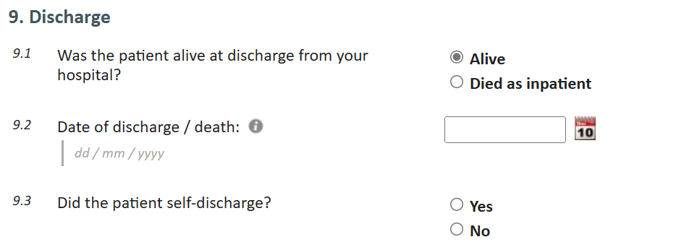
COPD Dataset Updates
Discharge
Changed question 9.3 from the v5 dataset from “Was a discharge bundle completed for this admission?” to “did the patient self discharge?”
  Important to capture those who self-discharged as this may affect discharge bundle completion.
  Removed wording asking if discharge bundle was completed as this can be calculated from the discharge bundle element question.

Slide 8
COPD Dataset Updates
Discharge
Q9.4 “Which of the following specific elements of a discharge bundle were undertaken as part of the patient’s discharge:”
  Elements have been updated in line with new BPT guidance (published April 2025).
  Updated the format of question to allow options to be ticked and provide clarity to show all elements should be completed in order to meet BPT criteria.

Slide 9
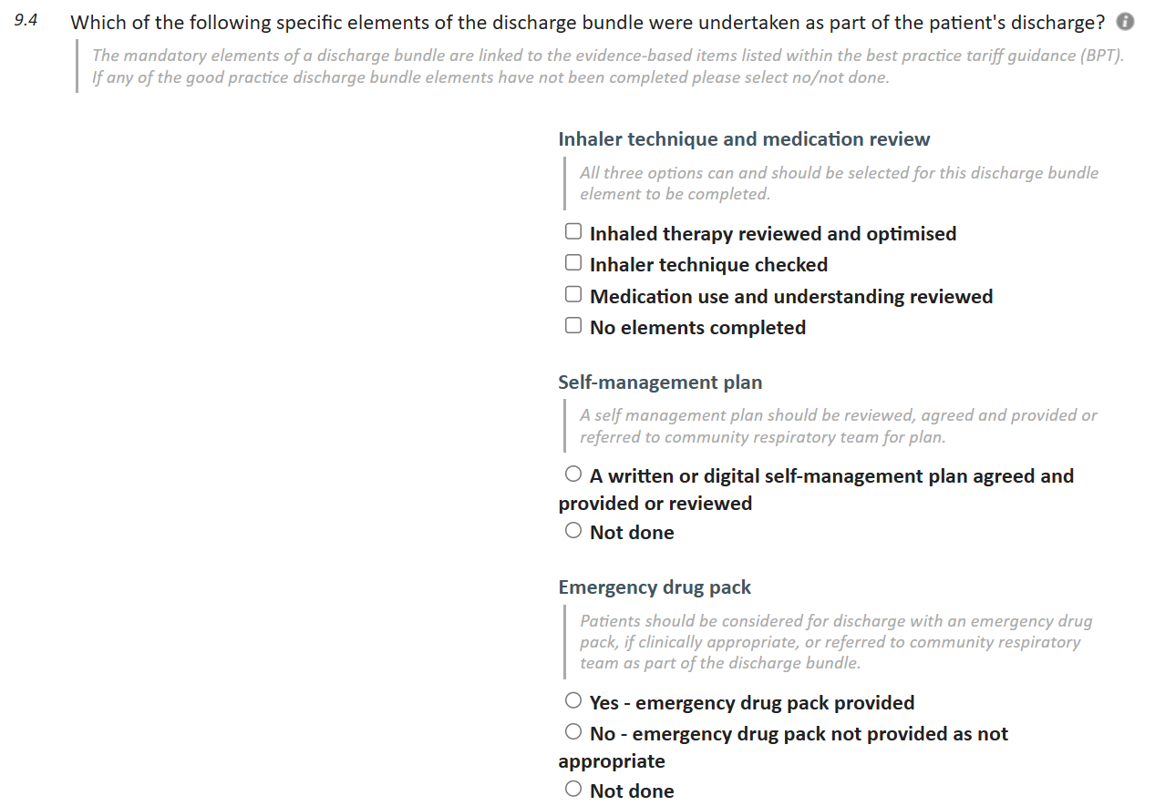
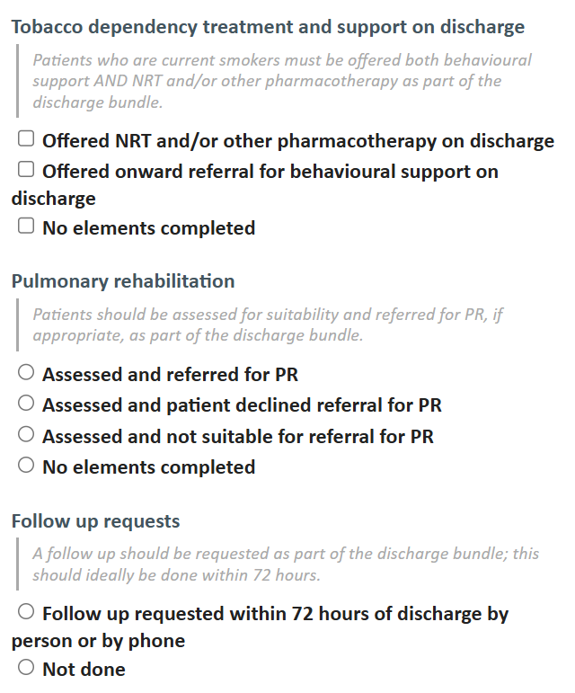
COPD Dataset Updates

Slide 10
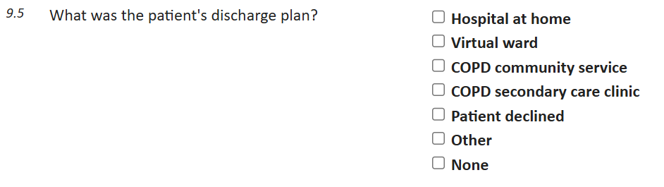
COPD Dataset Updates
Discharge
Q9.5 changed from additional elements of discharge bundle to “what was the discharge plan for this patient?”

Slide 11
Best practice tariff –2025/26 update
To qualify for the BPT, 60% of patients must receive specialist input within 24 hours of admission and a discharge bundle before discharge (that is, one patient needs to receive both care processes to be a success against the criteria).
A discharge bundle is a group of evidence-based items that should be implemented/checked and verified on discharge from hospital. The discharge bundle must include all the following mandatory elements:
Medication review including:
  – Maintenance medication reviewed and understood
  – Adherence discussed
  – Inhaler technique checked and optimised
Provision of a written or digital personalised self-management plan and where appropriate an emergency drug pack.
Tobacco dependence advice, treatment and referral (where appropriate).
Assessment of suitability for referral to pulmonary rehabilitation and referral where appropriate.
Ensuring that appropriate follow up arrangements are in place prior to discharge.
Evidence of the discharge bundle being delivered must be found in the case notes.
Guidance can be found here: NHS England » 2025/26 NHS Payment Scheme – Annex C: Guidance on best practice tariffs

Slide 12


Q&A

Slide 13
Thank you

