Slide 1

National COPD Audit Programme
An exercise in improvement
Pulmonary rehabilitation 2017
Clinical and organisational audits
Findings and quality improvement

Slide 2


















The audit programme partnership
Working in strategic partnership:
Supported by:
Commissioned by:

Slide 3

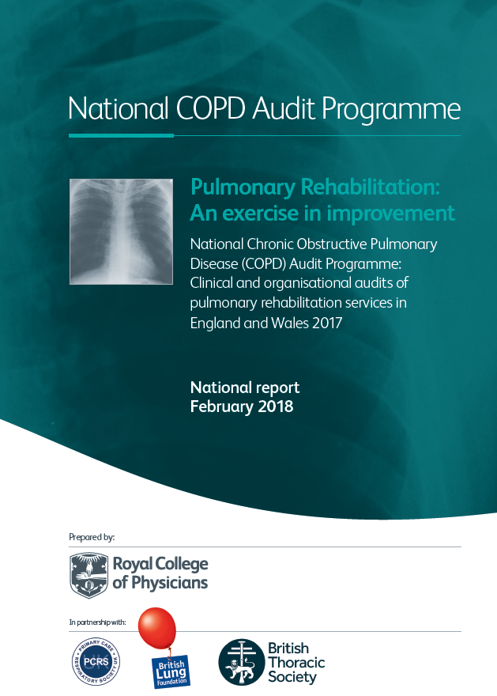

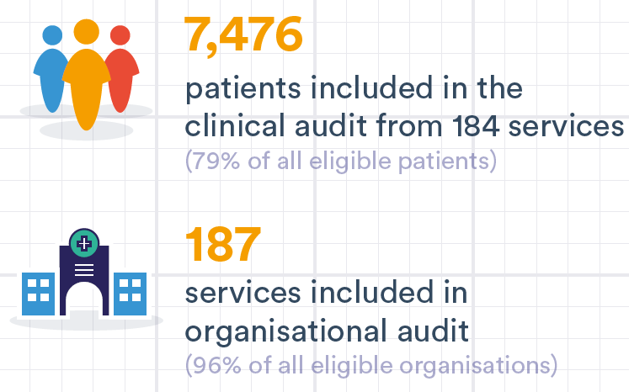
Report overview
Combined results from clinical and organisational snapshot audits
Including data from consenting patients and registered services from England and Wales for the early 2017 audit period
Participation

Slide 4

Key findings and recommendations

Slide 5

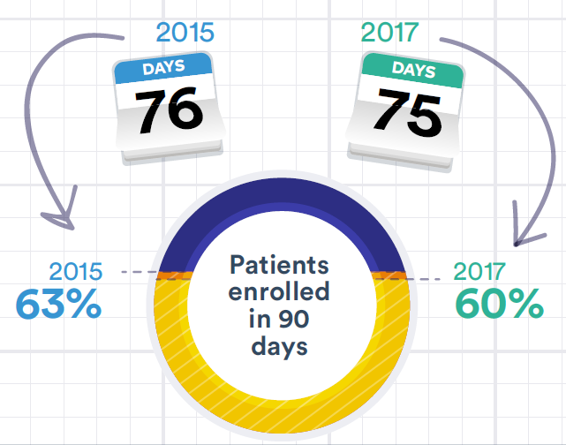
Access to PR
Key findings
The median waiting time between referral receipt and PR enrolment overall:

Slide 6


Access to PR
Key findings
Waiting times are longer for cohort than rolling programmes:
Percentage of patients starting PR within 90 days is higher in rolling than cohort programmes:
Cohort programmes
Cohort programmes
52%
Rolling programmes
Rolling programmes
66%

Slide 7


Access to PR
Key findings
2017
2015
Whilst the majority of services accepted patients with conditions other than COPD (eg asthma, lung cancer, heart failure), 5% do not.
92% of services accept patients with more severe disability (MRC grade 5), compared to 81% in 2015.

Slide 8




Access to PR
National QI priority
Reduce waiting times
Services should set an achievement target 85% enrolment of those referred for PR within 90 days.
How this priority was derived
Tips on how to achieve this
Services that solely run cohort programmes and struggle with waiting times:
BTS Quality Standard 1bᵃ
People referred for PR should be enrolled within 3 months of service receipt of referral.
Consider changing to a rolling design (or to a combination of the two) to deliver this objective.
Notes:
ᵃ British Thoracic Society. BTS quality standards for pulmonary rehabilitation in adults. London: BTS, 2014. www.brit-thoracic.org.uk/standards-of-care/quality-standards/bts-pulmonary-rehabilitation-quality-standards/

Slide 9

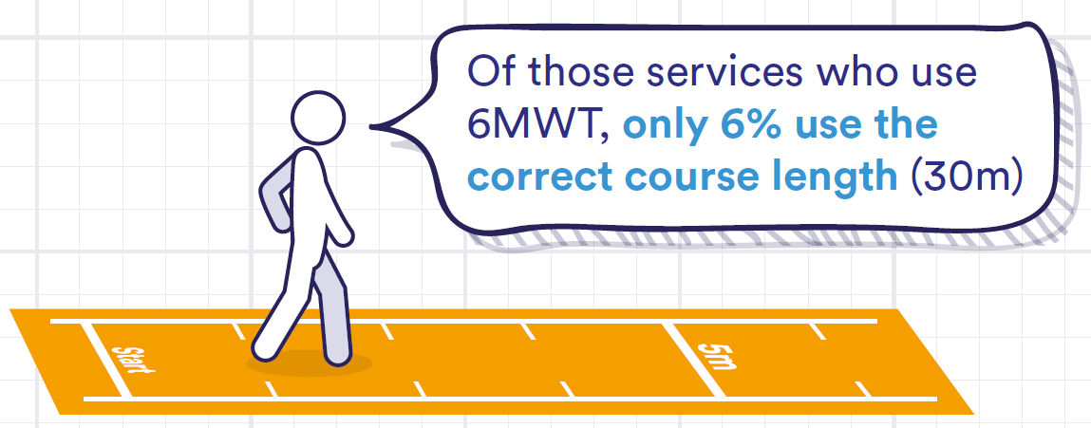
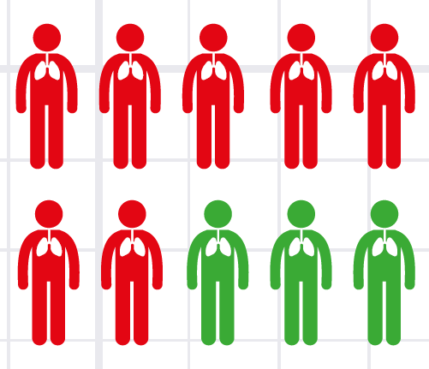

Quality of PR services
Key findings
68% of patients do not complete a recommended practice exercise test
* 6MWT = six minute walk test
10% of services did not offer individually prescribed aerobic or resistance training

Slide 10

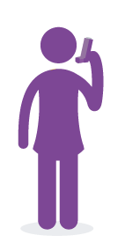

Quality of PR services
Key findings
2017
2015
84% of services (67% 2015) have a standard operating procedure for local policies
15%
27%
73%
85%
27% of patients had an assessment of muscle strength at baseline in 2017, a considerable improvement from 15% in the 2015 audit
Spirometry was reported for 60% of patients
BMI was reported for 70% of patients

Slide 11



Quality of PR services
National QI priority
Tips on how to achieve this
Exercise assessments should be performed to recommended technical standards
Including practice walks and lengths of walking courses
Space limitations may restrict walking course lengths for the 6MWT.
Where this is the case, consider switching to the ISWT which requires only a 10m course.
Guidance and standards ᵇ exist for each test, you might find it useful to use these in your planning.
30m
How this priority was derived
10m
2015 audit dataᵃ suggests PR outcomes were better in services that undertook practice walks (17% more likely to complete PR).
Notes:
ᵃ Hakamy A, McKeever TM, Steiner MC, Roberts CM, Singh S.J and Bolton CE. The use of the practice walk test in pulmonary rehabilitation program: National COPD Audit Pulmonary Rehabilitation Workstream. International Journal of COPD 2017;12:2681–6. www.dovepress.com/the-use-of-the-practice-walk-test-in-pulmonary-rehabilitation-program--peer-reviewed-article-COPD
ᵇ Holland AE et al. An official European Respiratory Society/American Thoracic Society technical standard: field walking tests in chronic respiratory disease. Eur Respir J 2014 Dec;44(6):1428-46. http://www.thoracic.org/statements/resources/copd/FWT-Tech-Std.pdf

Slide 12

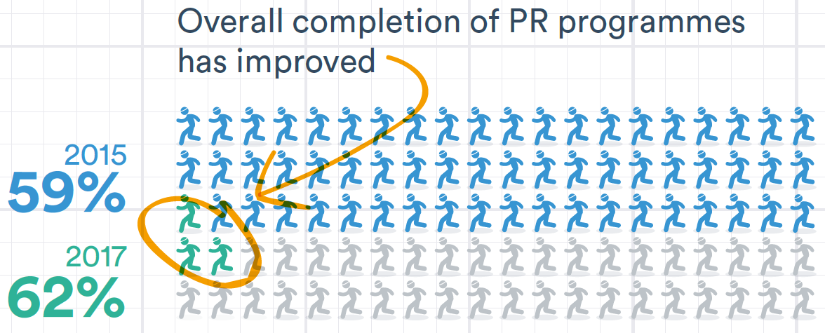
Outcomes of treatment
Key findings
There was no significant difference in outcome between patients enrolled on cohort or rolling programmes.
Clinical outcomes of patients who completed treatment were excellent (similar proportions met the MCID or surpassed it than did so in 2015).
2017
2015

Slide 13


Outcomes of treatment
National QI priority
Tips on how to achieve this
Increase completion rates
Following PR assessment, patient completion rates should be 70% or more
Review completion rates, to identify non-completion factors
Develop systems to identify patients at risk of exacerbation and hospital admission
Implement local strategies with specialist and community COPD teams to improve:
Diagnosis, the optimisation of drug treatment, management of co-morbidities, and the promotion of smoking cessation and winter vaccination
How this priority was derived
The 2015 PR outcomes reportᵃ found that PR completion was associated with lower hospital admission rates
Notes:
ᵃSteiner M, McMillan V, Lowe D, Saleem Khan M, Holzhauer-Barrie J, Van Loo V, Roberts CM. Pulmonary rehabilitation: Beyond breathing better. National Chronic Obstructive Pulmonary Disease (COPD) Audit Programme: Outcomes from the clinical audit of pulmonary rehabilitation services in England 2015. National supplementary report. London: RCP, November 2017. https://www.rcplondon.ac.uk/projects/outputs/pulmonary-rehabilitation-beyond-breathing-better

Slide 14

And so, what next?

Slide 15

Quality improvement
Using quality improvement methodology to plan a change (SMART)
Look for areas where you can realistically make improvements.
Decide on an aim, this should be SMART.
Build a team and understand your stakeholders.
Meet with your team regularly to performance manage yourselves, and have clear responsibilities.
Plan how you will achieve your aim.
S
Specific
M
Measurable
A
Achievable
R
Realistic
T
Time bound

Slide 16
Quality improvement
Defining your overall aim (driver diagrams)
To decide what to start on for your overall improvement aim, you may find it helpful to use a driver diagram.
The Institute for Healthcare Improvement has a helpful guide on how to use them http://www.ihi.org/resources/Pages/Tools/Driver-Diagram.aspx
Aim Primary drivers Secondary drivers

Slide 17
Driver diagram example
Aim Primary drivers Secondary drivers
To increase the number of eligible patients being referred for and completing PR
Referrer and patient awareness of PR
Identify patients in primary and acute care who are eligible for PR
Provide clear information on benefits of PR for referrers
Provide clear information for patients about PR
Enhance use of discharge bundles that include PR referral
Easy to navigate referral pathways for PR
Develop system prompts to remind users to refer eligible patients
Embed evidence or quality standards in prompts
Streamline referral forms to remove unnecessary information and speed the process
Ease of patient access to PR services
Ensure patients are assessed and enrolled within 3 months of referral
Ensure sites are accessible by patient transport
Ensure exercise prescription is individually tailored
Ensure patient access is highlighted in accreditation metrics
Use audit data feedback to drive referrals
Real-time feedback of referral rates to referrers
Real-time feedback of clinical outcomes and drop-out rates to PR programmes
Develop commissioner incentives linked to referral and uptake rates to drive up referrals

Slide 18
Quality improvement
A model for improvement
To plan your change it is important to regularly measure and study your activity using:
Model for improvement
What are we trying to accomplish?
How will I know that a change is an improvement?
What changes can we make that will result in improvement?
Aim
Measure
Change
Act
Plan
Do
Study
Rapid cycle improvement

Slide 19
Quality improvement
The PDSA cycle
Act
Plan
Do
Study
What changes are to be made?
Next cycle?
Objective
Questions and predictions (why)
Plan to carry out the cycle (who, what, where, when)
Complete the analysis of the data
Compare data to predictions
Summarise what was learned
Carry out the plan
Document problems and unexpected observations
Begin analysis of the data

Slide 20
Quality improvement
The PDSA cycle example: non completion by patients
Act
Plan
Do
Study
ACT: Identify what still needs to change to improve what you will do next
(Next PDSA cycle)
PLAN: Would changes to the patient information sheets help with non completion rates?
STUDY: Analyse data to see if the rate has improved. Plot the change over time and summarise what you have learned.
DO: Adapt the paperwork and information sheets according to patient feedback, making it more informative and easier to understand.

Slide 21
Quality improvement
The PDSA cycle example: non referral by GPs
Act
Plan
Do
Study
ACT: Identify what still needs to change to improve what you will do next
(Next PDSA cycle)
PLAN: How many patients would you expect to see referred from your local GP surgeries?
STUDY: Have your referral rates gone up? Analyse data to see if the rate has. Plot the change over time and summarise what you have learned.
DO: Hold awareness raising sessions with GP surgeries in the local area, to discuss it further with GPs and surgery staff.

Slide 22
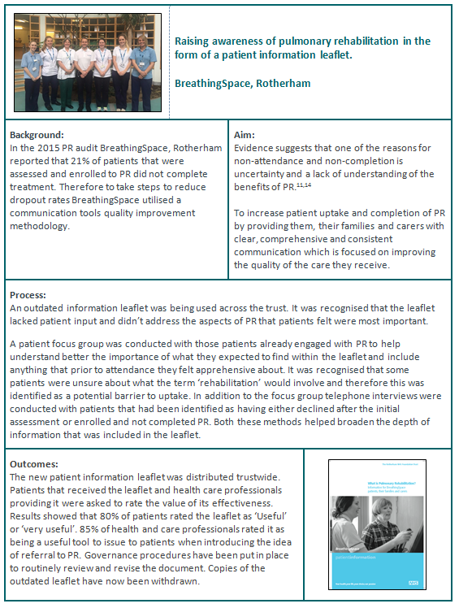
Quality improvement
Case study
… to reduce drop out rates [they looked at] providing patients, their families and carers with clear, comprehensive and consistent communication.
Quality improvement case study: BreathingSpace, a pulmonary rehabilitation service in Rotherham, describe a QI project performed locally to increase patient completion.
80% of patients rated the [new] leaflet as ‘useful’ or ‘very useful’. 85% of health and care professionals rated it … a useful tool to issue to patients when introducing … PR.

Slide 23
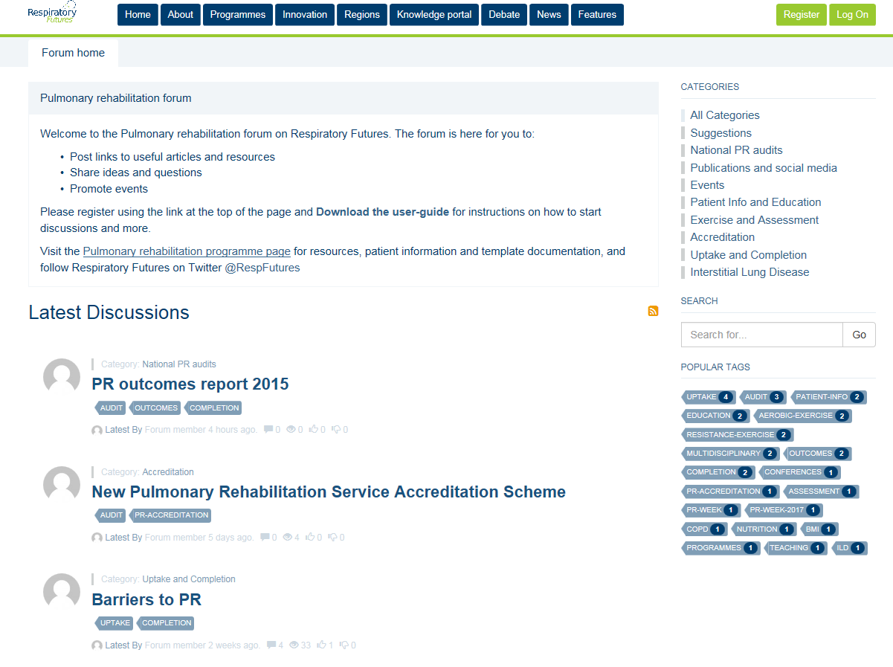
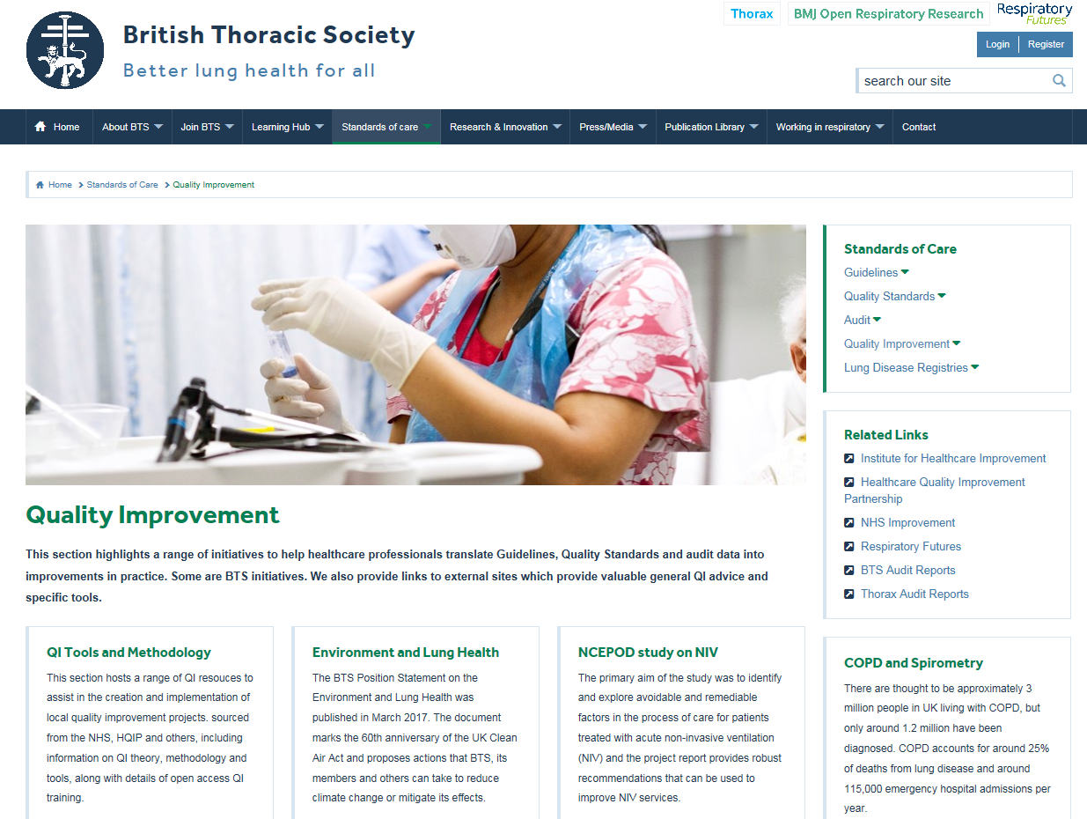
Useful quality improvement resources
Sharing learning
Respiratory Futures have a PR page http://www.respiratoryfutures.org.uk/programmes/pulmonary-rehabilitation/ and forum http://www.respiratoryfutures.org.uk/pulmonaryrehabforum
The British Thoracic Society page has useful resources and signposts https://www.brit-thoracic.org.uk/standards-of-care/quality-improvement/

Slide 24
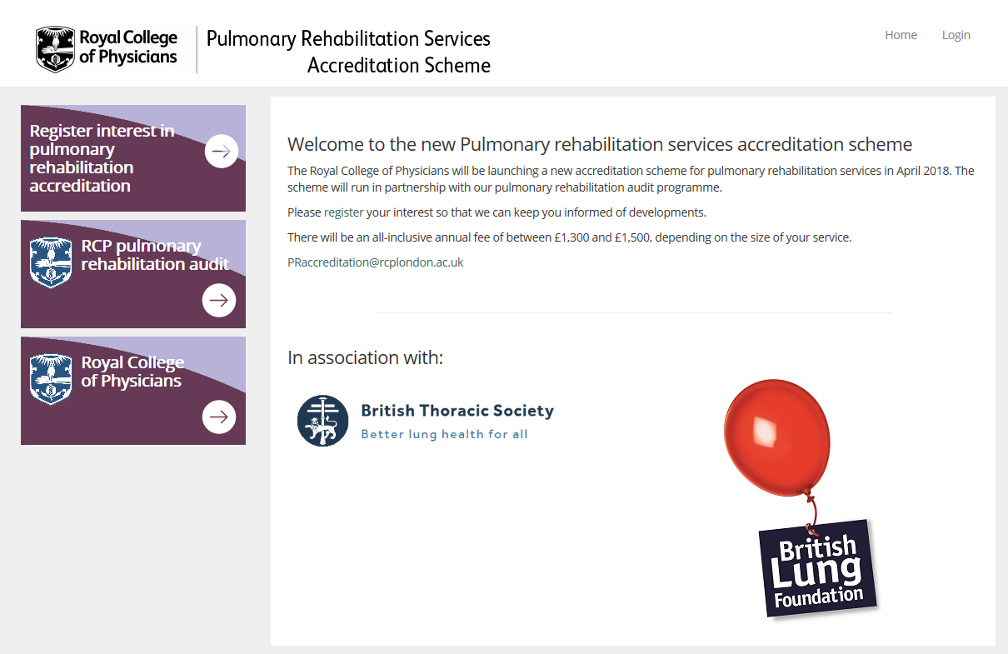
Useful quality improvement resources
Accreditation
Check out the new website for the Pulmonary Rehabilitation Accreditation scheme to read more about the scheme and how to apply
http://www.prsas.org/

Slide 25
National COPD Audit Programme
pulmrehab@rcplondon.ac.uk
020 3075 1526
www.rcplondon.ac.uk/COPD

